Slide 1
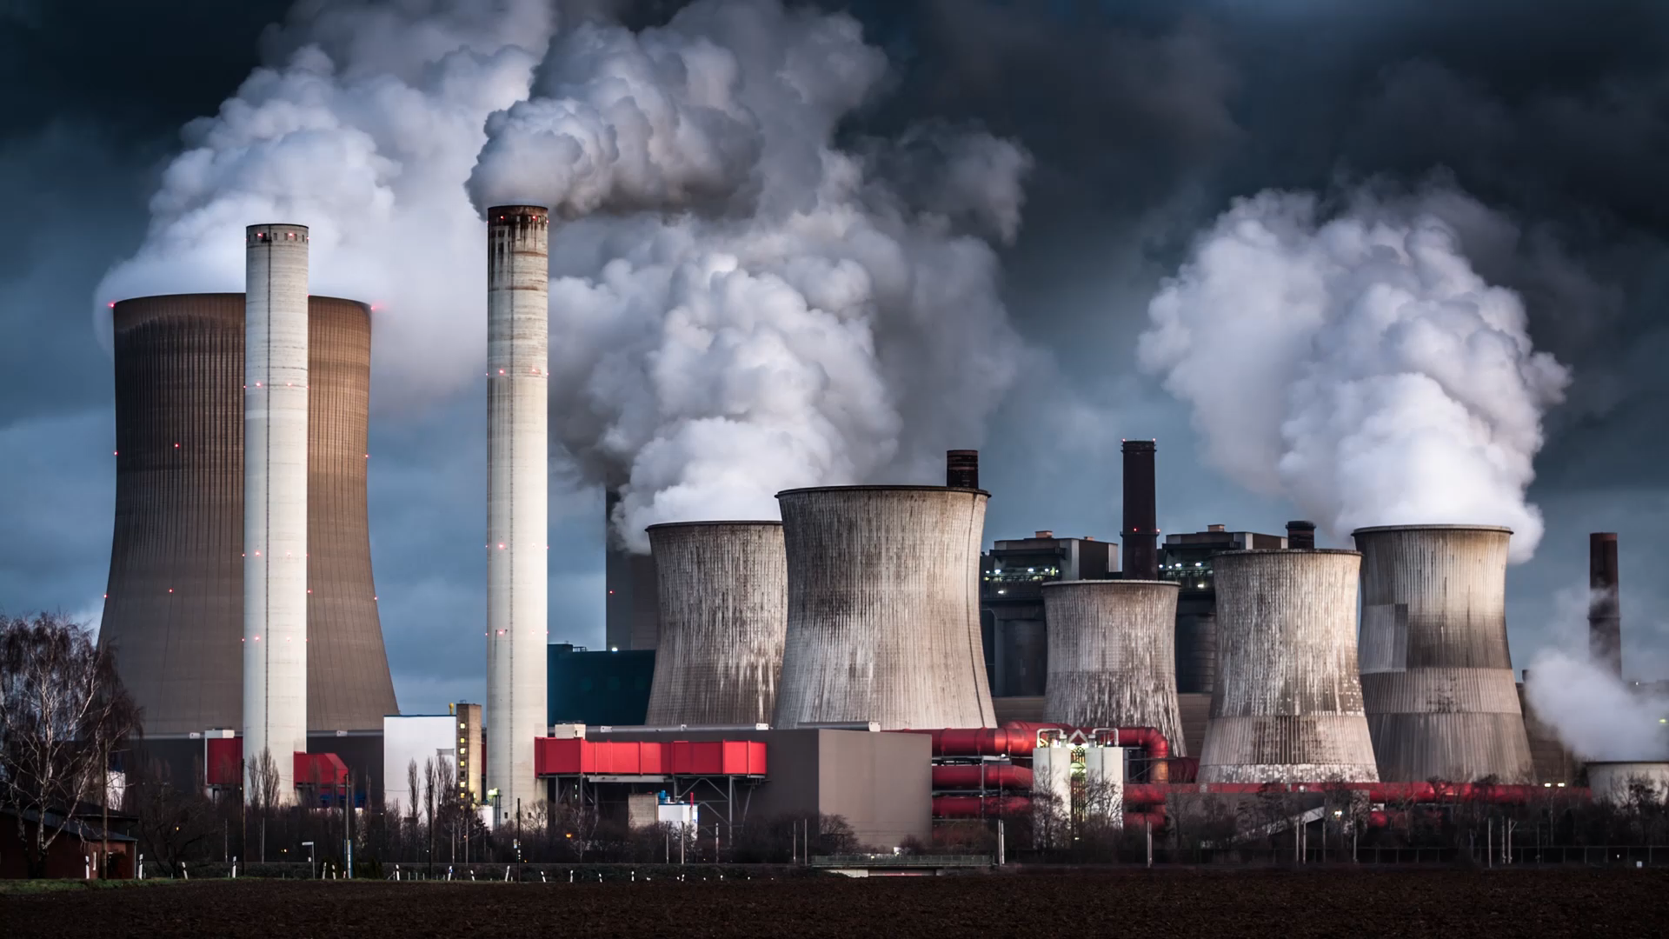
Coal Power Plants and Housing Discrimination
Fall 2022 Econ 181/315
By JeQa Powe
Joshua Blonz Lucy Cordes, Thomas Kaupas

Slide 2
History: Minorities, Housing, and Discrimination
Historically, minority housing practices have been egregiously preferential at best and discriminatory at worst
“Manifest Destiny” and effect on Indigenous People ending in treaties & displacement
Non-Enforced/Discriminatory Bills of Congress
Homestead Act, Freedman’s Act & bank closing
Comprehensive Drug Abuse Prevention and Control Act of 1970
Recently: Fair Housing Act ending in Redlining, Gentrification & discriminatory housing covenants
Notes:
https://www.americanprogress.org/article/systemic-inequality-displacement-exclusion-segregation/
https://www.occ.treas.gov/about/who-we-are/history/1863-1865/1863-1865-freedmans-savings-bank.html
Sood, A., Speagle, W., & Ehrman-Solberg, K. (2019). Long shadow of racial discrimination: Evidence from housing covenants of Minneapolis. SSRN Electronic Journal. https://doi.org/10.2139/ssrn.3468520

Slide 3
Coal Power Plants, Housing, and Discrimination
Causes mass migration to areas with more disamenities
Less fertile land, less favorable laws around natural resources, etc.
Minorities are far more likely to live in these areas because of these reasons
Relation: Coal Plants emit smog which has massive negative health effects
Notes:
https://www.propublica.org/article/toxmap-poison-in-the-air

Slide 4
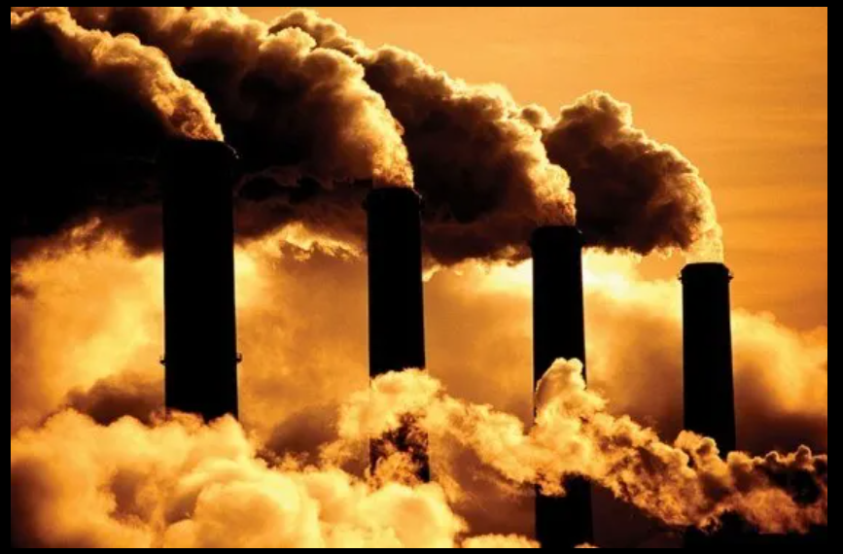
Research Question
Are blacks and other minorities more likely to live near a power plant?
Hypothesis is yes due to historical bias against them
Are they more likely to make less money living near a power plant?
Hypothesis is yes due to less preferential land and business practices
Notes:
Picture: https://d3.harvard.edu/platform-rctom/submission/coal-power-vs-climate-change/
By V. Rubeus Alumni POSTED NOV 4, 2016

Slide 5


Data Exploration - Sourcing
The dataset is sourced from both the US Energy Information Administration (EIA) and 2000 Decennial Census
Census data: Income, ethnicity, age
EIA: Power plant locations
Notes:
https://www.eia.gov/
https://www.census.gov/

Slide 6
Data Exploration – Key Variables
Power Plant Present
Ethnicity (Black, White, Hispanic)
Income Data
Urban vs Rural
Weighted and shown in percentages

Slide 7
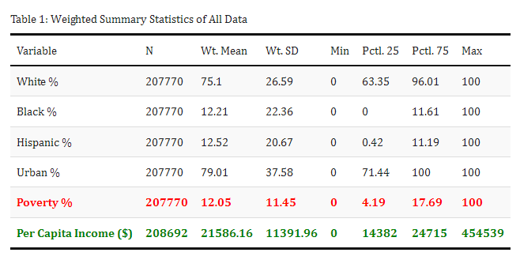
Summary Statistics
Notes:
General notes: Weighted SD is half of mean noting outliers
Majority of population in our data is in urban areas

Slide 8
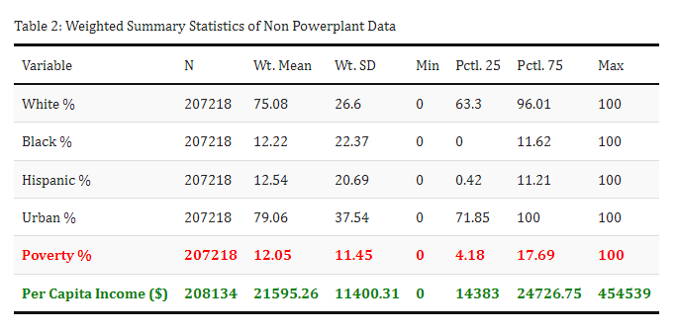
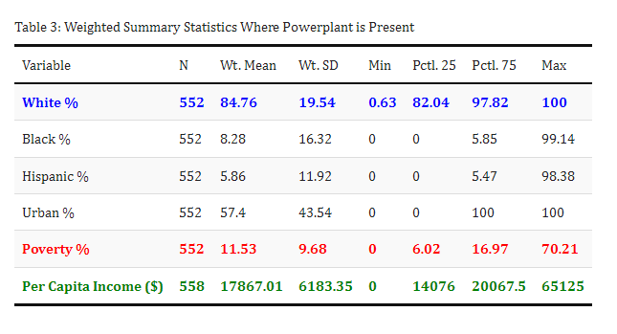
Grouped Summary Statistics by Power Plant Presence
Notes:
Fall in Black Population %

Slide 9
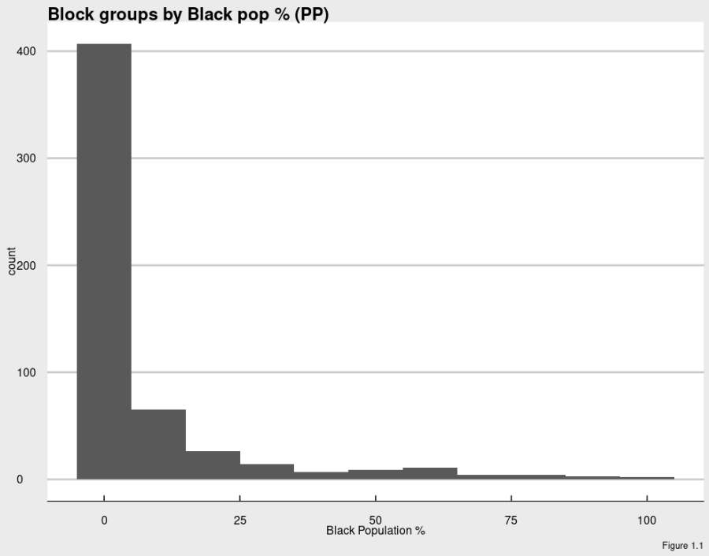
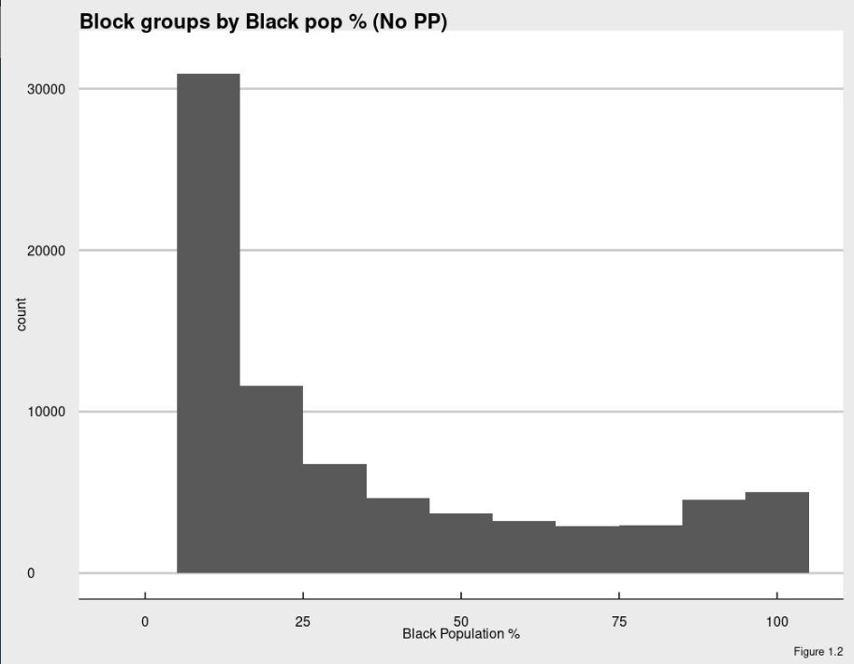
Grouped Distribution – Black Pop %

Slide 10
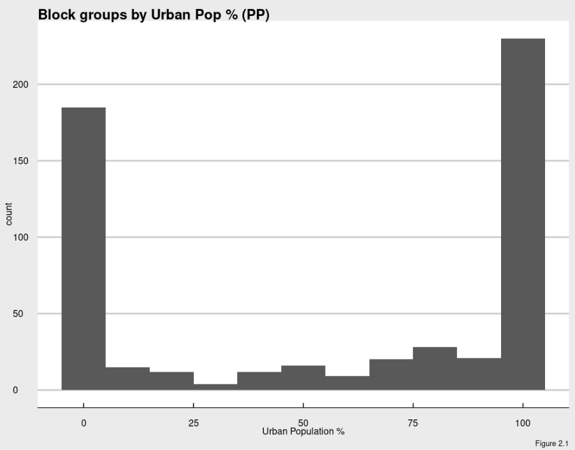
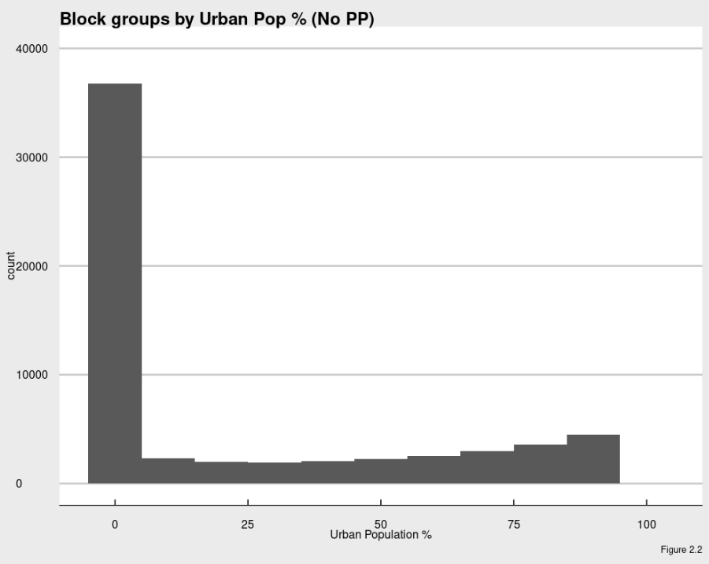
Grouped Distribution – Urban Pop %

Slide 11
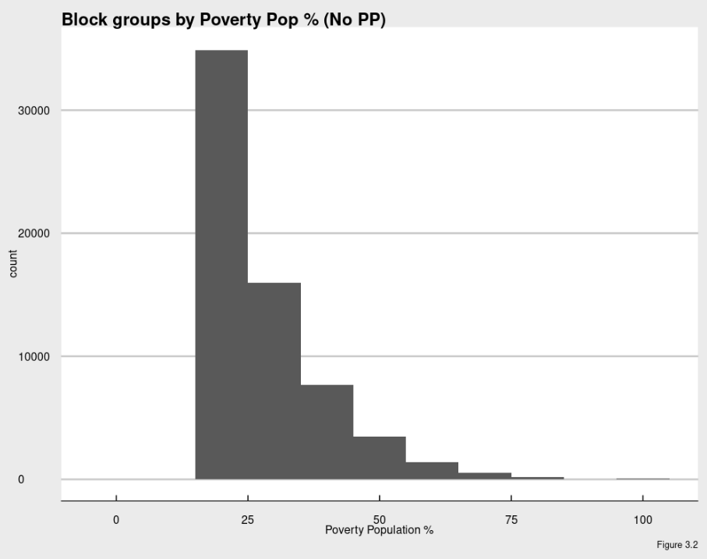
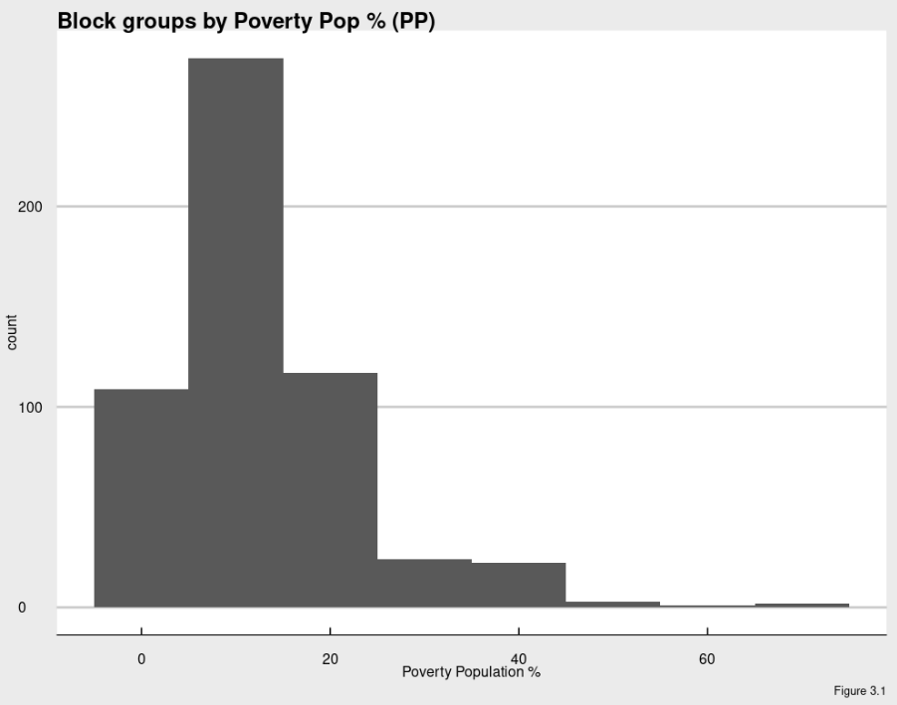
Grouped Distribution – Poverty %

Slide 12
Initial Conclusions from Data Exploration
White pop % increases while minority pop % decreases in proximity to plants
Poverty % decreases when plants are present but not significantly
Per Capita income increases when not near plants
Demographic (pop) | Mean (No PP) | Mean (PP) | P-Value
White % | 75.08 | 84.758 | 0
Black % | 12.219 | 8.283 | 0
Hispanic % | 12.537 | 5.865 | 0
Urban % | 79.061 | 42.602 | 0
Poverty % | 12.047 | 11.528 | .207
Per Capita Income | $21,595.26 | $17,867.01 | 0
Table 4

Slide 13
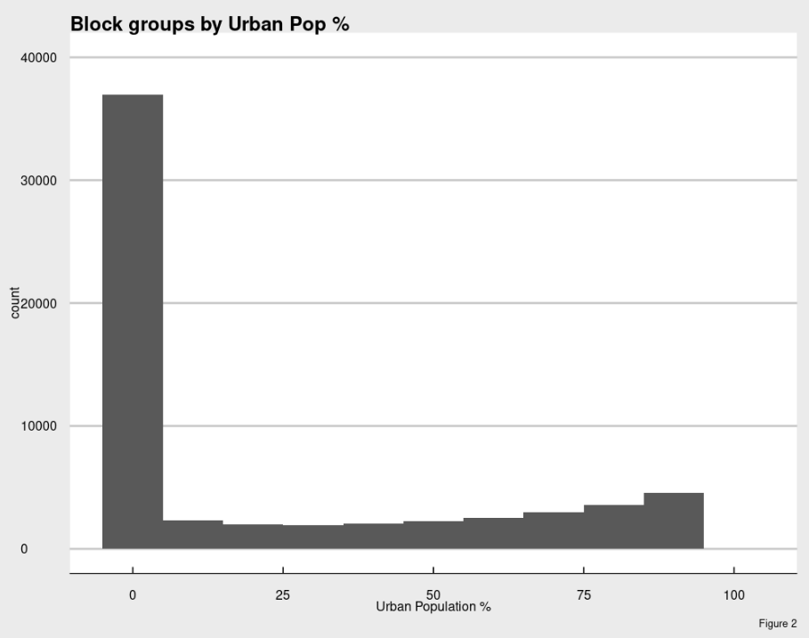
Data Analysis
Some of these points are counter intuitive to our hypothesis
We will look at rural data as more power plants are located in these areas (figure 2)
We examine the correlation between the locations of power plants and the effects they have on the populations

Slide 14
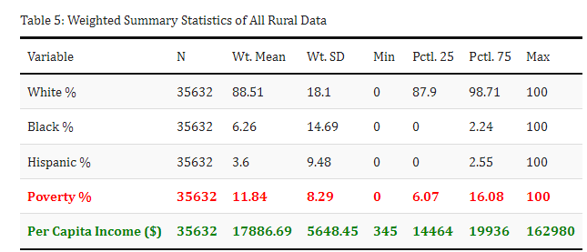
Rural Data – Summarize Statistics
Examining this data will show us a more detailed look at population groups and income statistics
Generally already in rural areas
White pop %, PCI, and poverty % fall (12%, ~$4,000, and 1%, resp.)
Hispanic and Black pop % increased (6% and 9%)

Slide 15
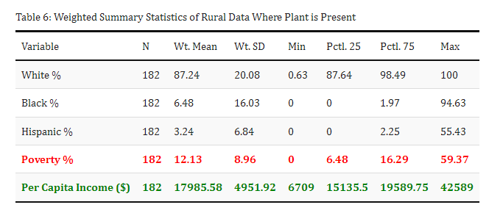
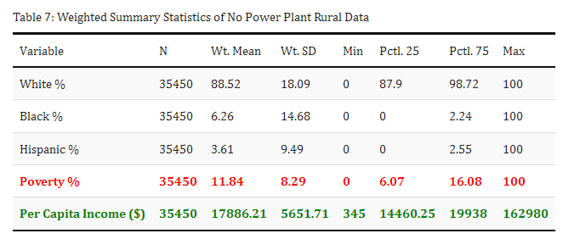
Rural Data – Grouped by Power Plant

Slide 16
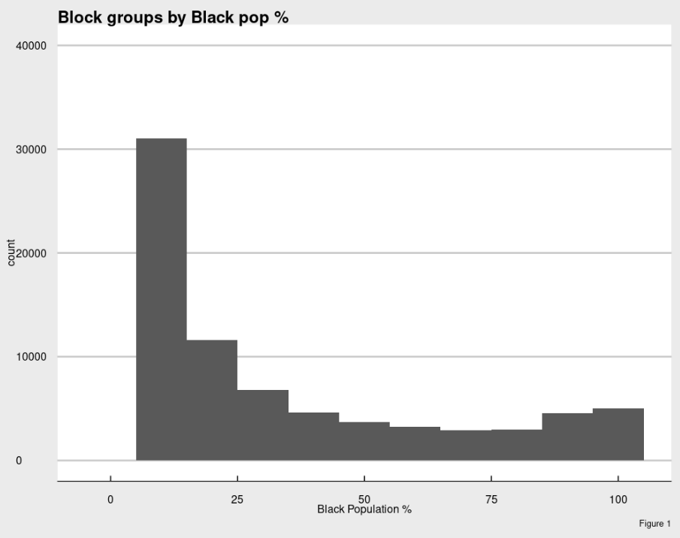
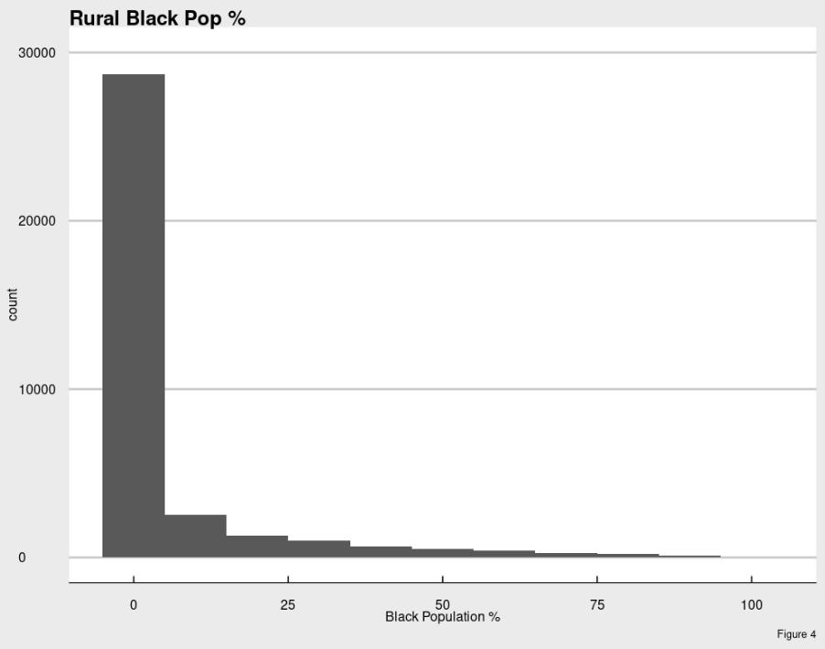
Distribution Comparison – Black Pop %
All Data
Rural

Slide 17
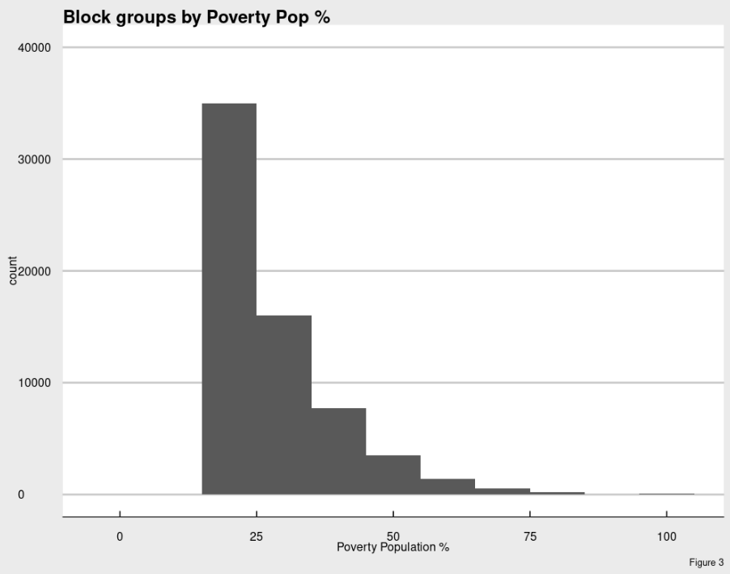
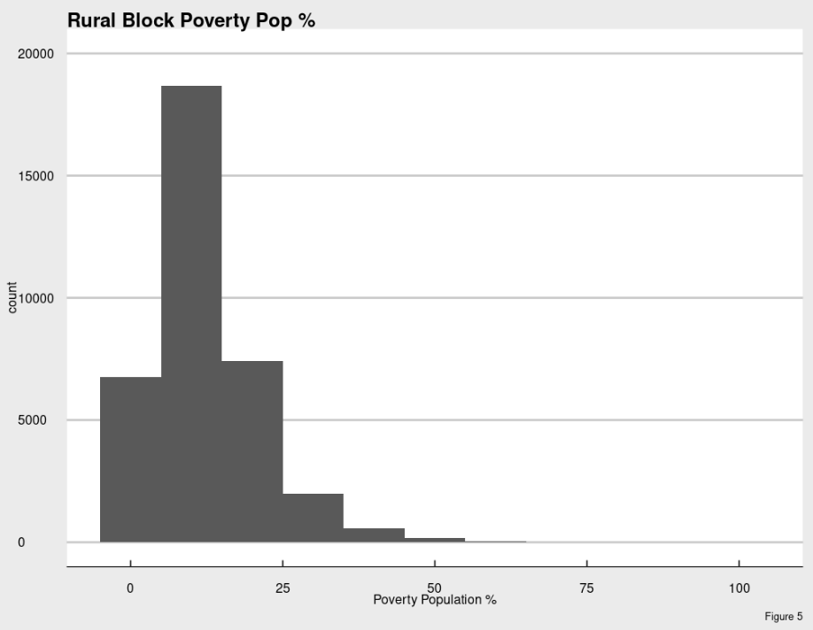
Income Distribution Comparison by Poverty %
All Data
Rural

Slide 18
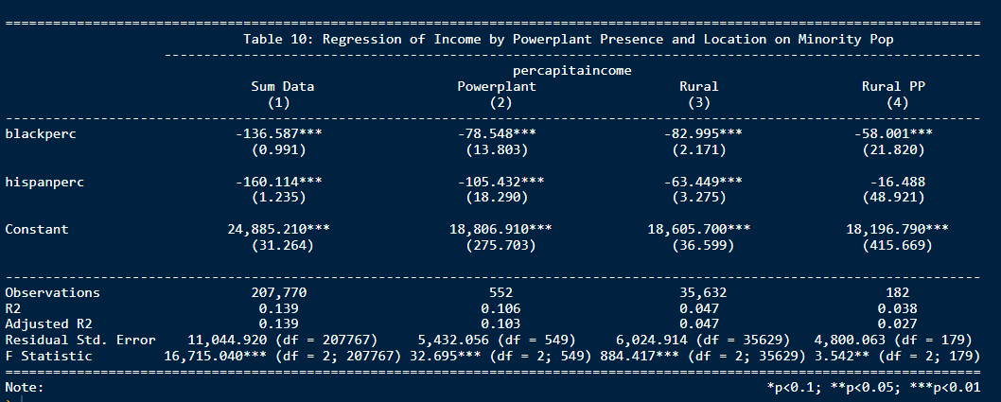
Rural Data – Effect on Income
In comparison to the White pop, Blacks and Hispanic pops have a lower income across all categories
This effect is lessened when near a power plant, even though PCI is lower on average
This means that power plant has a positive effect on income for these populations
Notes:
All data is significant except Hispanic in rural areas near powerplants

Slide 19
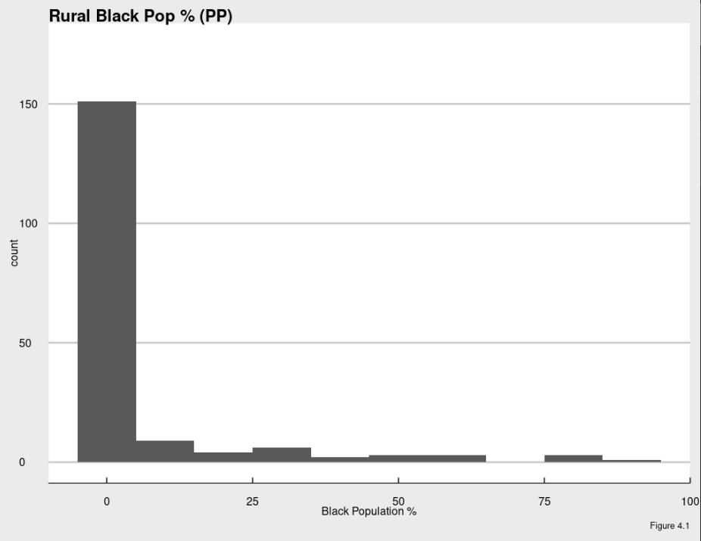
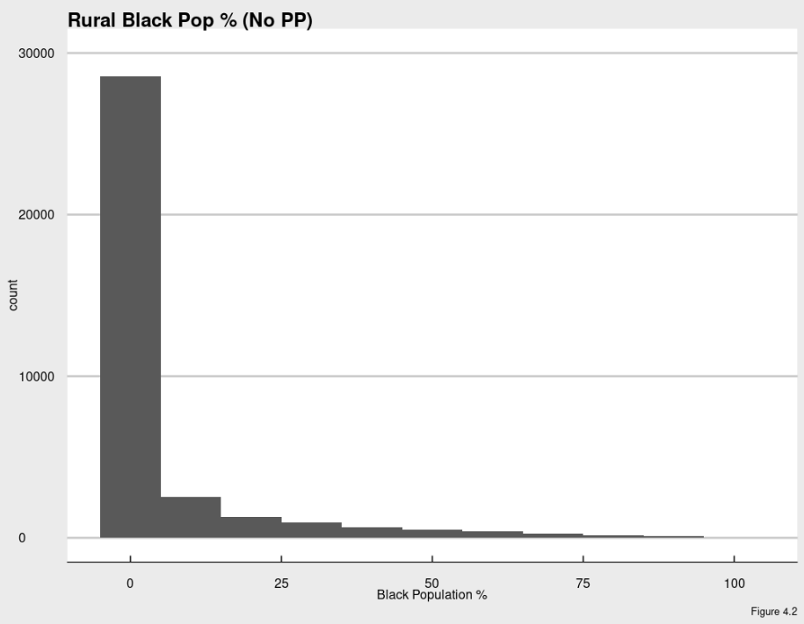
Rural Distribution Comparison – Black Pop %

Slide 20
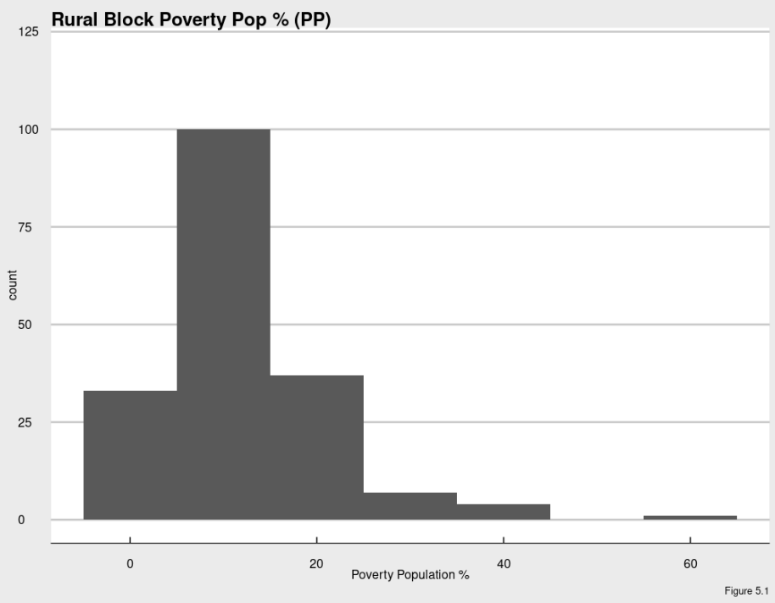
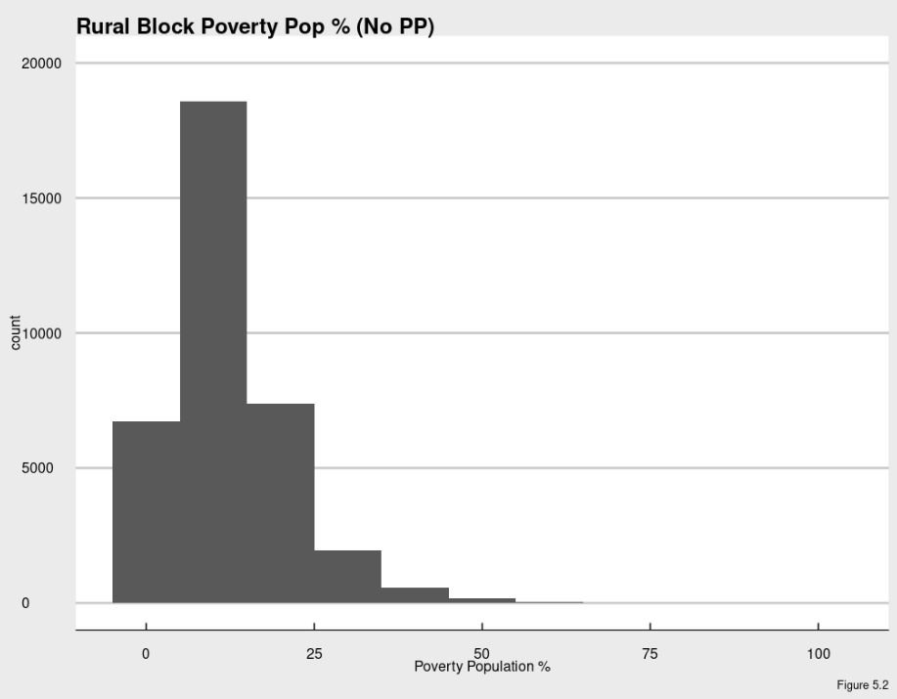
Rural Comparison – Poverty Population %

Slide 21
Regression of & analysis
Black pop % decrease when not near power plant While White and Hispanic % increase
Poverty % and PCI decrease without the presence of plants
Rural Demographics | Means (PP) | Mean (Non-PP) | P-Values
White % | 87.242 | 88.517 | 0
Black % | 6.483 | 6.260 | 0
Hispanic % | 3.240 | 3.607 | 0
Poverty % | 12.127 | 11.841 | 0
PCI | $17,985.58 | $17,886.21 | 0
Table 9
Notes:
All significant

Slide 22

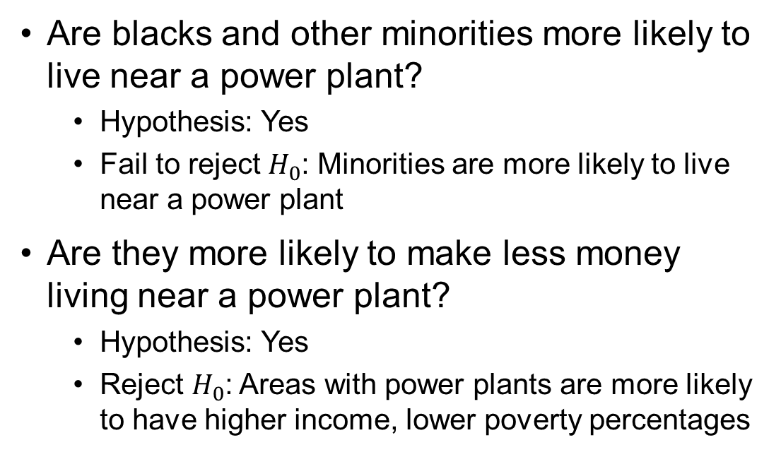
Analysis and Conclusion
Are blacks and other minorities more likely to live near a power plant?
Hypothesis: Yes
Fail to reject $H_{0}$: Minorities are more likely to live near a power plant
Are they more likely to make less money living near a power plant?
Hypothesis: Yes
Reject $H_{0}$: Areas with power plants are more likely to have higher income, lower poverty percentages

Slide 23
Key Takeaways
Power plants are more likely to be located in rural areas
In urban areas, whites are more likely to live near power plants while in rural areas, blacks are more likely
The presence of power plants has a positive correlation with income statistics
Notes:
Possibly due to more space, land, less population (further research needed)

